Slide 1

Zomato Restaurants Expansion
Hemlata Gund
18th May 2025
Zomato Restaurants Expansion
Name- Hemlata Gund
Date-18/05/2025

Slide 2
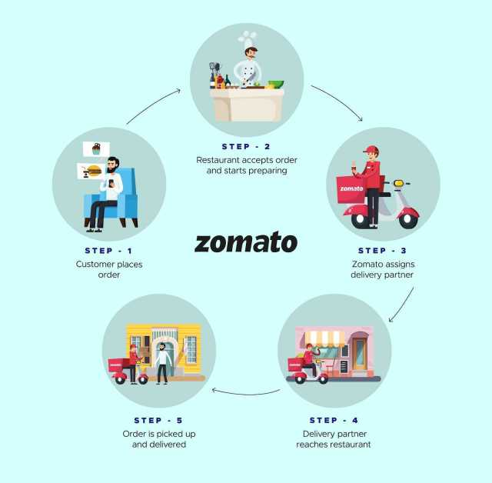
About Zomato
Zomato is an international restaurant aggregator and food delivery company based in India. It provides information, menus, and user reviews of restaurants, as well as food delivery options from partner restaurants in over 1,000 Indian cities.

Slide 3

Zomato Restaurant Expansion
The global food delivery industry is set to hit $1.5 trillion by 2030, yet several booming cities remain untapped!!
Project Objectives
✔ Identify target countries and cities with low competition but high demand for new restaurants.
✔ Analyze restaurant quality and customer ratings to ensure expansion success.
✔ Leverage pricing trends, cuisine preferences, and food expenditure data for strategic decision-making.
✔ Evaluate competitor strengths and weaknesses to enhance market entry strategies.
✔ Identify target countries and cities with low competition but high demand for new restaurants.
✔ Analyse restaurant quality and customer ratings to ensure expansion success.
✔ Leverage pricing trends, cuisine preferences, and food expenditure data for strategic decision-making.
✔ Evaluate competitor strengths and weaknesses to enhance market entry strategies.

Slide 4

Objective Analysis
✔ Dataset Composition: Contains two tables (Raw Data & Country Description).
✔ Attributes Count: 20 attributes in Raw Data, 2 attributes in Country Description.
🖼 Visual Representation:
📊 Bar Chart – Comparing categorical vs. numerical attributes.

Slide 5
Data Overview
Data Cleaning & preprocessing:
Handling Missing Values: Used COUNTBLANK function to identify blank cells for cleaning.
Lookup Approach: Applied VLOOKUP for Country Name mapping from Country Code.
Pivot Table Usage: Created summary tables for restaurant distribution by country and opening year.
Conditional Formatting: Highlighted rows based on recommended expansion cities (Turkey, Australia, Philippines, etc.).
Dataset Summary
✔ Total Restaurants: 15,000+
✔ Active Users: Over 25 million monthly users
✔ Order Volume: 500,000+ daily transactions
Data Cleaning & Preprocessing
✔ Handling missing values using COUNTBLANK function
✔ Using VLOOKUP for finding Country from Country Code
✔ Creating Pivot tables for restaurant distribution by country and year

Slide 6
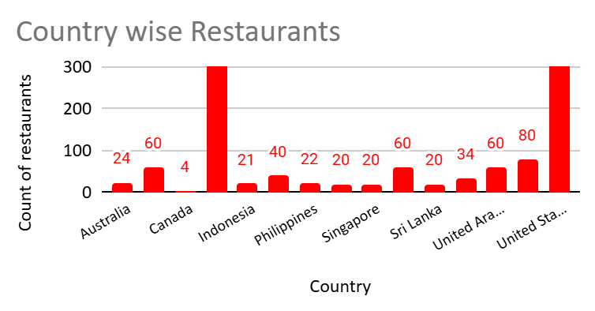
Restaurants Distribution
Plotted countries against count of restaurants to find expansion potential
Insights
✔ Low restaurant count indicates low competition in those countries
✔ High restaurant count indicates high competition in those countries

Slide 7
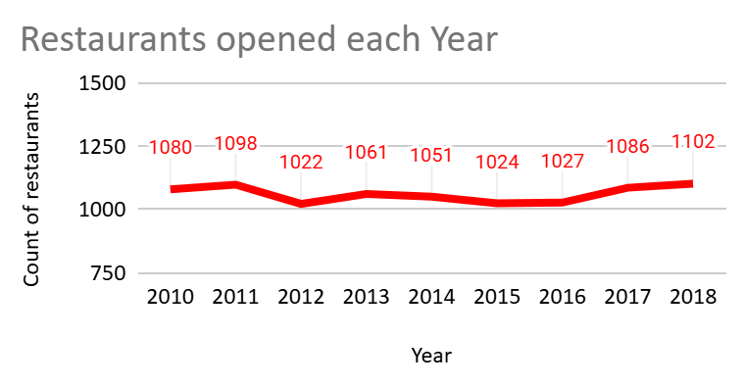
Restaurant Trends & Expansion Strategy
Insights
✔ In year 2012, minimum number of restaurants are opened i.e.1022
✔ In year 2018, higher number of restaurants are opened i.e.2018

Slide 8
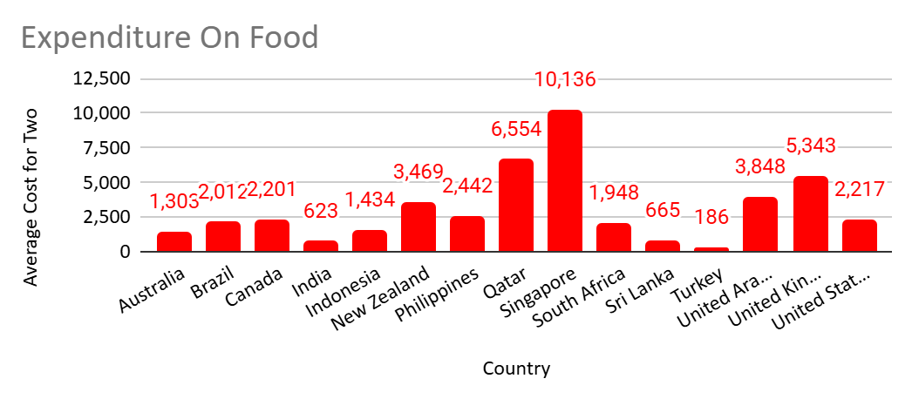
Current Expenditure on Food
Insights:
✔ Singapore and Qatar have highest dining costs indicating strong spending power
✔ New Zealand, UK,UAE are mid to high cost markets
✔ Brazil, Canada, USA show moderate dining costs
✔ India, Sri Lanka and Indonesia are highly price sensitive.

Slide 9
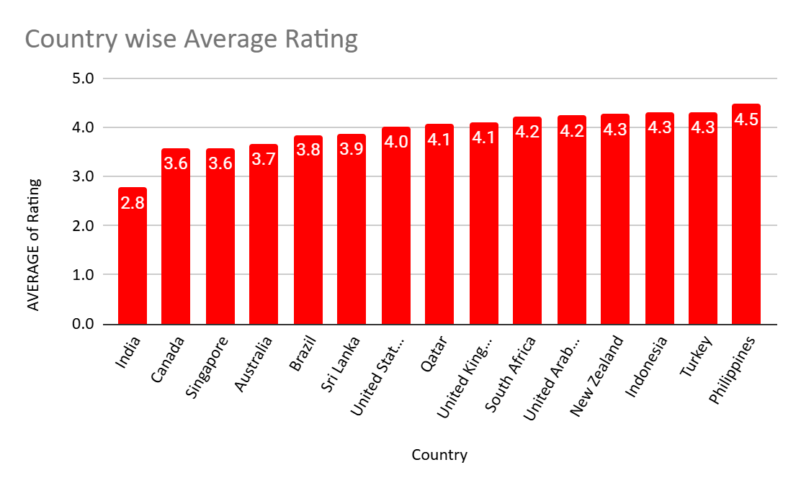
Average Restaurant Ratings
Highest Rated Countries:
Philippines (4.5), Turkey (4.3),Indonesia(4.3) and New Zealand (4.3)
Lower Rated Countries:
Sri Lanka (3.82), Australia (3.62), Singapore (3.58), Canada (3.58)
Insights
✔ Higher ratings indicate higher customer satisfaction.
✔ Countries with Rating >4 and less number of restaurants indicates greatest potential.
Hence from this we can suggest Philippines, Turkey, Indonesia.

Slide 10
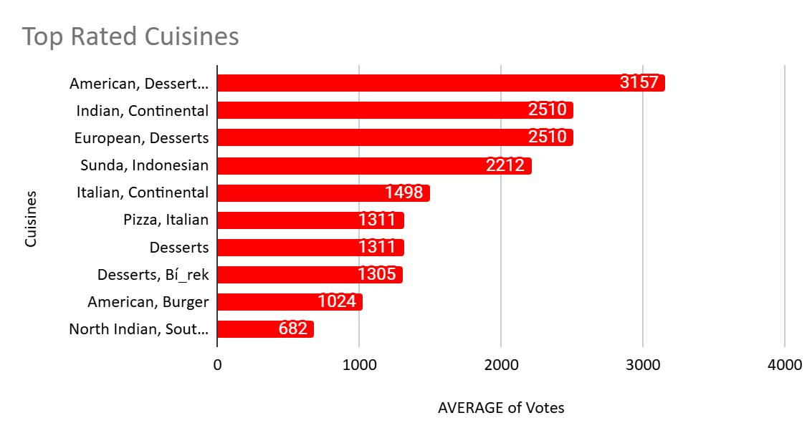
Top Cuisines by Votes
Plotted Cuisines as per the number of votes received and then found out Top voted from all.
Insights
✔ American, Desserts, Steaks has received Topmost votes(3157) whereas
Indian, Continental and European, Desserts, Sunda also have good votes(2510)

Slide 11
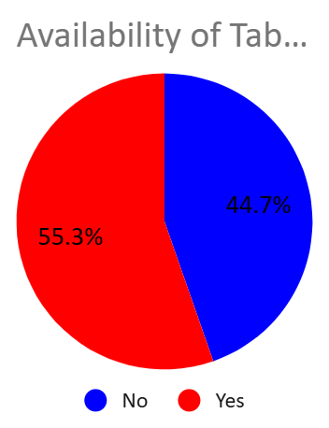
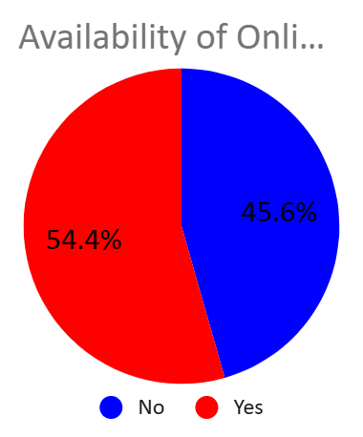
Additional services
Pie Charts for checking Table Booking and Online Delivery facility
Insights
✔ Adding Table Booking and online delivery would be highly beneficial for restaurants improving efficiency and unlocking new revenue stream.
✔Together they enhance customer experience, leading to better ratings

Slide 12
Conclusion
Where to open New Restaurants?
Based on the data analysis of restaurant count, average rating, and cost for two persons, countries such as Canada, Australia, Indonesia, Qatar, Philippines, Turkey etc. emerge as ideal locations for new restaurant expansion. These countries exhibit low market saturation, favorable customer ratings, and affordable dining costs, which collectively present a strong potential for successful market entry and business growth.

Slide 13
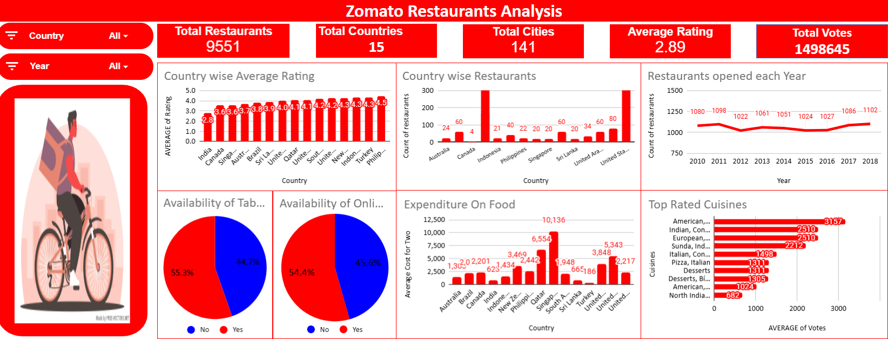
Dashboard

